Slide 1
FluidMem: Full, Flexible and Fast Memory Disaggregation for the Cloud
Blake Caldwell†, Youngbin Im‡, Sepideh Goodarzy, Sangtae Ha, Richard Han, Eric Keller, Eric Rozner
Department of Computer Science
University of Colorado Boulder
† Currently at Brown University, USA
‡ Currently at UNIST, South Korea

Slide 2
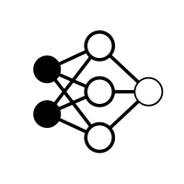



Motivation: a memory-intensive graph application
Memory usage
Time
Notes:
I’d like to start out with an application use case that motivates a solution like FluidMem. Let’s take a hypothetical graph analytics application with very high memory needs
This application first goes through an initialization phase with increasing memory usage, followed by a drop in memory usage for a less demanding phase of analysis.

Slide 3




Moving to the cloud
Memory disaggregation decouples resources from individual servers
Memory usage
Time
FluidMem enables transparent memory disaggregation in the cloud
Requires developer time required to modify application and partition the graph over multiple nodes
Notes:
We could rent a larger system in the cloud, but what happens when our graph grows even larger or we once again underestimated our memory usage… The application will still crash
What we need is a new solution… this is where memory disaggregation can help.

Slide 4
Full memory disaggregation
Memory usage
Time
Full memory disaggregation in FluidMem enables the VM footprint to be reduced
Wasted infrastructure capacity costs customer $ and is not available for other customers
Notes:
there’s another aspect though… what happens when memory usage decreases. Do we have to continue to pay for all of that capactity?

Slide 5
Outline
Uniqueness among related works
FluidMem architecture
FluidMem page fault handling
Evaluation
Conclusion
Notes:
So with an example of full memory disaggregation in the cloud, here is an outline for the rest of this talk presenting FluidMem

Slide 6
Outline
Uniqueness among related works
FluidMem architecture
FluidMem page fault handling
Evaluation
Conclusion

Slide 7


Related work
 | Network overhead | Kernel integration | Heavyweight OS modifications | Full memory disaggregation
Distributed Shared Memory (DSM)
Partitioned Global Address Space (PGAS)
Key-value stores
Single System Images (SSI)
Memory disaggregation by swap
FluidMem
FluidMem meets all requirements of memory disaggregation in cloud environments
Notes:
DSM was one of the earliest proposed software systems that would expand memoy capacity beyond a single node. However it suffered from excessive network traffic necessary to maintain coherency in a shared global address space. While many implementations would be made transparent to the user as part of the kernel, it required an OS rewrite or large patches that never made it to wide distribution. It is unclear how full memory disaggregation would be supported in these large coherent address space
PGAS lacks the system-level integration to provide extra memory in a transparent way to VM’s
Quickly mention key-value stores (for example using RAMCloud by itself). These share the same pros and cons as partitioned gloabal address space
Single system images is kind of the best of both DSM and PGAS. However, it’s patches were still too significant to make part of the linux kernel

Slide 8
FluidMem benefits
Full memory disaggregation
Through user space page fault handling, the VM footprint can be reduced to near-zero
Flexible
A new user space page fault handler that can easily be extended
Implements modular support of different key-value backends
Fast
Despite user space page fault handling, average latencies are comparable to leading swap-based implementations

Slide 9
Outline
Uniqueness among related works
FluidMem architecture
FluidMem page fault handling
Evaluation
Conclusion

Slide 10
FluidMem architecture
Full memory disaggregation is controlled via a LRU list
Modular interface for key-value remote memory storage
Only minimal modifications to the Linux virtualization stack
Patches have been proposed for merging remaining functionality into Linux kernel

Slide 11
Outline
Uniqueness among related works
FluidMem architecture
FluidMem page fault handling
Evaluation
Conclusion

Slide 12
Increasing memory usage (part 1)
2. Record page address in LRU buffer
1. VM stop
4. VM resume
5. Evict oldest page in LRU (asynchronous)
3. Allocate local memory page for VM
Memory usage
Time

Slide 13
Increasing memory usage (part 2)
2. Match page address in LRU buffer
1. VM stop
3. Retrieve memory page
5. VM resume
6. Evict oldest page in LRU (asynchronous)
4. Copy memory page into VM process address space
Memory usage
Time
Notes:
In the lower left corner, we have a memory usage plot to remind

Slide 14
Reducing memory footprint
1. Cloud operator reduces LRU buffer size
VM may experience more frequent page faults, but handling will continue as usual
2. Evict pages no longer in LRU list
Memory usage
Time

Slide 15
Outline
Uniqueness among related works
FluidMem architecture
FluidMem page fault handling
Evaluation
Page fault latency
Application: Graph500
Application: MongoDB
Conclusion

Slide 16
Non-Volatile Memory express over Fabrics (NVMeoF)
Included in Linux since 4.8
Local block device that is backed by a remote server
Uses RDMA for network transfers

Slide 17
Infiniswap: swap-based memory disaggregation
Efficient Memory Disaggregation with Infiniswap
Gu et al., NSDI 2017
Similar to NVMeoF, a local block device enables swapping to remote memory over RDMA
Supports adding and removing servers
Reduces CPU load on remote server using RDMA

Slide 18
Comparing remote fault latency on hypervisor
CloudLab servers
64 GB DRAM, FDR Infiniband (56 Gbit/s), Linux kernel 4.10
3 configurations
FluidMem
Infiniswap
NVMeoF
Application workload
Pmbench on hypervisor (no virtualization)
100% random reads, then 100% random writes
99.93% remote accesses (10 MB local memory)

Slide 19
RAMCloud backend for FluidMem
RAMCloud¹ is a distributed in-memory key-value store suitable for datacenter infrastructures
User space support for Infiniband and DPDK (Ethernet) network transports
Options for providing replication
Impact would be on write latency (asynchronous in FluidMem)
Does not take advantage of RDMA
[1] J. Ousterhout et al., “The RAMCloud Storage System,” ACM Transactions on Computer Systems, vol. 33, no. 3, pp. 7:1–7:55, Aug. 2015.

Slide 20
FluidMem configuration

Slide 21
Infiniswap/NVMeoF configuration

Slide 22
Remote page fault latency from hypervisor
Page access latency (microseconds)
 | Read 99% | Write 99%
Infiniswap | 63.5 | 262.1
FluidMem | 53.2 | 57.3
NVMeoF | 86.0 | 172.0
FluidMem decreases tail latencies
Notes:
This plot is showing the cumulative distribution functions for page access latencies with Infiniswap, FluidMem, and NVMeoF, where on the y-axis we have the

Slide 23
Comparing local page fault latencies within VM
Local cluster servers
64 GB DRAM, FDR Infiniband (56 Gbit/s), Linux kernel 4.20
Configurations
FluidMem
NVMeoF
Application workload
Pmbench within VM
100% random reads, then 100% random writes
75% “remote” accesses

Slide 24
FluidMem (DRAM) configuration

Slide 25
Swap (DRAM) configuration

Slide 26
Local page fault latencies within VM
FluidMem
Swap
Average access latency: 24.84 µs
Average access latency: 26.34 µs
FluidMem decreases average page fault latency compared to swap
FluidMem avoids overheads to swap page fault pathway

Slide 27
Application use case: Graph500
Loads a graph into memory of configurable scale factor
Performs Breadth First Search (BFS) 64 times and returns Traversed Edges per Second (TEPS)
Page fault latency and page eviction choice will affect performance
Run on local cluster
1 GB local DRAM

Slide 28
Graph500 performance in DRAM
600 MB Graph
Overhead of userfaultfd page fault handling is small (2.6%)

Slide 29
Graph500 performance: 120% of DRAM
1.2 GB Graph
When kernel memory can be stored remotely, application performance improves

Slide 30
Graph500 performance: >120% of DRAM
More visibility into all page accesses improves performance with swap
See paper for more comparisons

Slide 31
Application use case: MongoDB
MongoDB is a document store commonly used for cloud applications
Uses its own caching strategy (WiredTiger)
Workload: YCSB scan (100% 1 KB reads) on a client VM reading records from the MongoDB server
Non-sharded configuration for the server
4 GB local DRAM

Slide 32
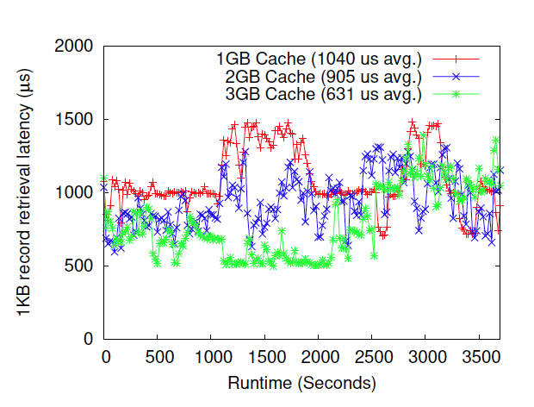
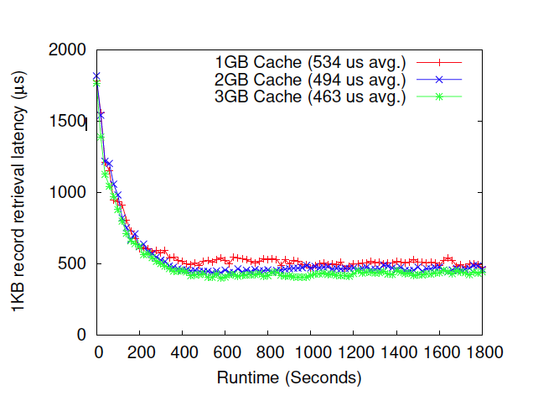
MongoDB performance
1KB read latency with NVMeoF swap
1KB read latency with FluidMem (RAMCloud)
Application-level caching (WiredTiger) conflicts with kernel-based swapping
FluidMem transparently extends the physical memory in the VM and results in smooth performance

Slide 33
Demonstrating full memory disaggregation
Existing method (VM balloon driver) can only decrease VM memory footprint to 64 MB
Using FluidMem a VM can respond by opening up an SSH session with 180 pages (720 KB) in DRAM
See paper for more details

Slide 34
Outline
Uniqueness among related works
FluidMem architecture
FluidMem page fault handling
Evaluation
Conclusion

Slide 35
Conclusion
FluidMem implements full memory disaggregation in cloud computing environments
User-space page fault handler provides more flexibility than swap-based memory disaggregation
FluidMem performance is comparable to swap-based disaggregation and even outperforms in some cases because of full memory disaggregation
FluidMem is on GitHub:
https://github.com/blakecaldwell/fluidmem

Slide 36
Acknowledgements
Funding from NSF: CCF Grant No. 1337399
Infiniswap and RAMCloud authors
Students Daniel Zurawski, William Mortl, and Kannan Subramanian for early work on FluidMem

Slide 37

Thank you

